Slide 1
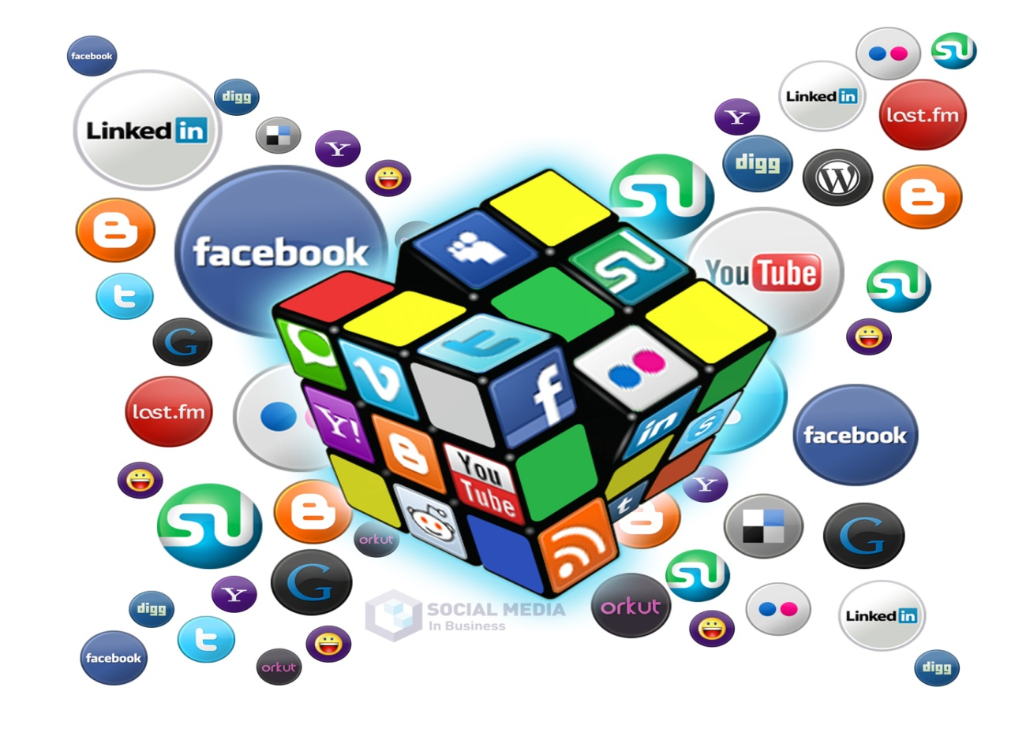
Why is social media a beneficial relationship-building tool?

Slide 2
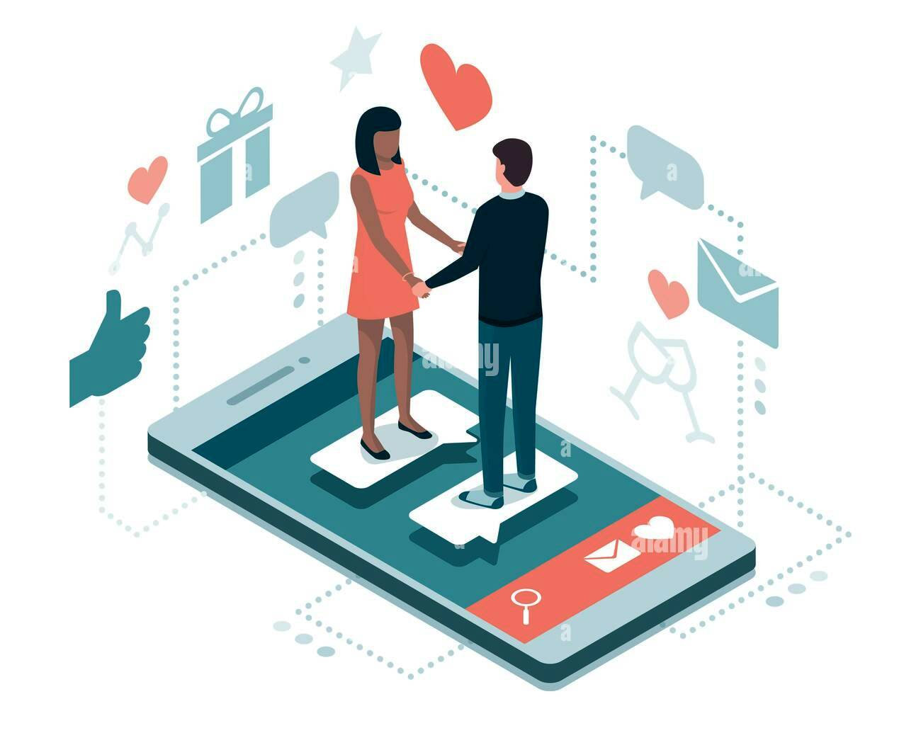
Factual arguments 1/2
Expert say that social media helps relationships about 13% more than it hurts them. In a recent study, Pew Research discovered that social media has an impact on 66% of relationships. But, contrary to popular belief, this impact is usually positive.
Experts found that social media solved many daily problems and made our life easier: between 2012-2021 more than 40% of people work and study using social media,

Slide 3
Factual arguments 2/2
One other category that is often overlooked is people who are either not that comfortable with some aspects of face-to-face conversation but find online interaction to be liberating. It's not that these people are not seeking human contact. It's just that they find it hard to make that initial connection. They are the people who don't dominate conversations, the people who appear shy, are less outgoing, and feel nervous talking to new people. Sometimes it's because they are different from the people around them.

Slide 4
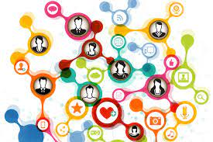
Emotional arguments 1/2
First, it’s allowing us to connect with
more people more rapidly.
Second, it’s easy to overestimate the level of intimacy of our online relationships.

Slide 5
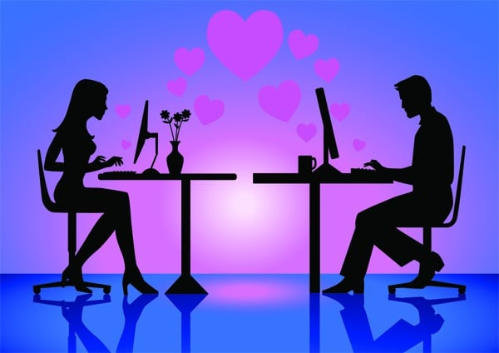
Emotional arguments 1/2
Third, it makes us more susceptible to a sort of social media contagion effect, which means you may possibly start adopting behaviors, attitudes, and beliefs from those within your social network.

Slide 6
Rational arguments:
Social network presents great opportunities for professionals to publicly recognize the successes of parties in the relationship. This increases that party’s sense of belonging, self-worth, and security, in turn, makes them more comfortable and more likely to invest in your relationship.
Another key opportunity provided by social networking is authenticity. Others can utilize your social media pages to determine more information about you as an individual. This helps to reassure others the story you are telling about yourself is genuine, and as a result, the connections you make are as meaningful as face-to-face relationships.
A great thing about social media is that it allows you access to both your strong and weak connections. Increasing the spectrum of possible connections can help individuals and organizations identify specific parties with shared interests or goals, experience solving similar challenges, or even developed tools or methods for completing a mutual task. Consider all the connections you have online through social networks and then think about the connections of your connections: the possibilities for collaboration are endless!

Slide 7
THANK YOU FOR YOUR
ATTENTION

